Slide 1


Welcome to (Facility Name)

Slide 2
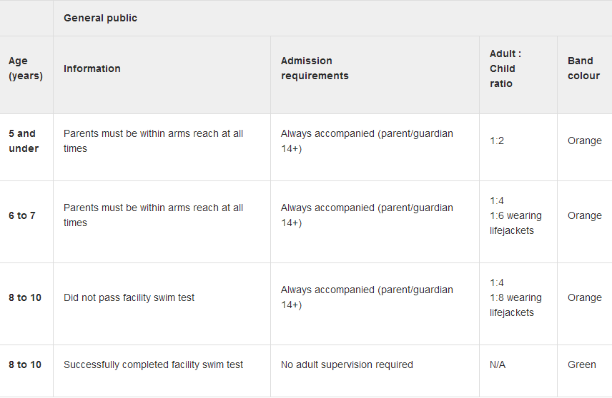
Admission Standards

Slide 3
Lane Swim Schedule
Monday | Tuesday | Wednesday | Thursday | Friday | Saturday | Sunday
0630-0900 | 0630-0900 | 0630-0900 |  | 0630-0900
1000-1400 | 1000-1400 | 1000-1400 | 1000-1400 | 1000-1400 | 1000-1400 | 1000-1400
1700-2130 | 1600-2130 | 1700-2130 | 1600-2130 | 1600-2130

Slide 4
Family Swim Schedule
Monday | Tuesday | Wednesday | Thursday | Friday | Saturday | Sunday
 |  |  |  |  | 1330-1500 | 1330-1500
 |  |  |  | 1600-1700 | 1500-1600 | 1500-1600
 |  |  |  | 1700-1800

Slide 5
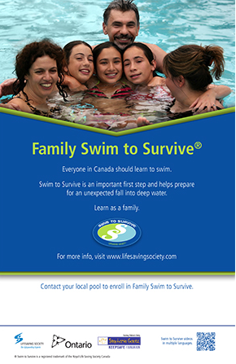

Slide 6

What is Swim to Survive?
Can you?
1) ROLL into deep water
2) TREAD water for one minute
3) SWIM 50 metres
These are the minimum skills needed to survive an unexpected fall into deep water.

Slide 7
Aqua Fitness Schedule
Monday | Tuesday | Wednesday | Thursday | Friday | Saturday | Sunday
0900-1000 |  | 0900-1000 |  | 0900-1000

Slide 8
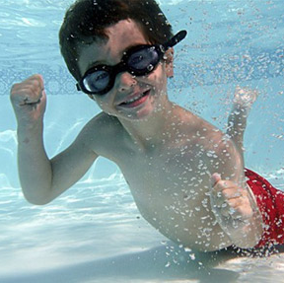
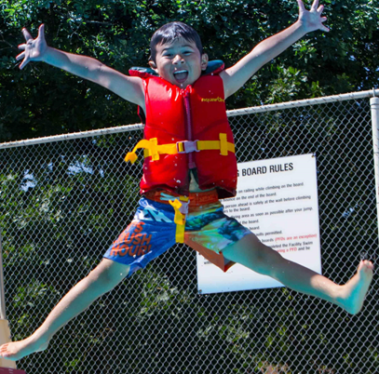

Register for Swimming Lessons today!

Slide 9

Leadership courses!

Slide 10
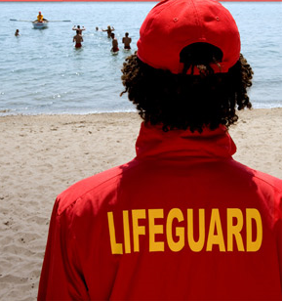
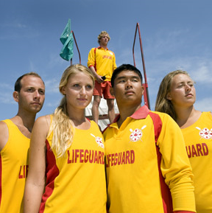
Lifeguards Wanted!
Apply today!

Slide 11
Bronze Star
Bronze Medallion
Bronze Cross
Standard First Aid with CPR C
National Lifeguard
Lifesaving Instructors
Airway Management

Slide 12

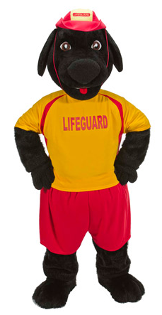
Get ready for summer!

Slide 13


Slide 14
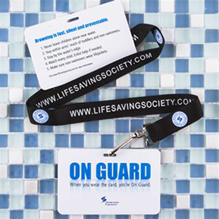
Backyard BBQ Essentials!
To learn more, ask a Lifeguard!

Slide 15
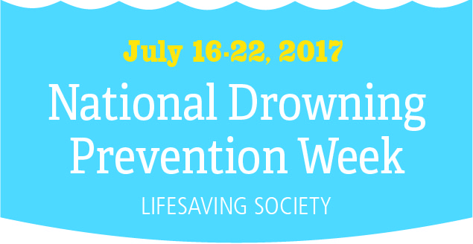
#ndpw2017
@LifesavingON

Slide 16
If you’re not within arms’ reach, you’ve gone too far. Always supervise children.
Approximately 166 Ontarians die in preventable water-related incidents annually. Even one drowning is one too many

Slide 17
Choose It. Use It. Always wear a Lifejacket or PFD.
Boat sober. Alcohol consumption is a factor in almost 40% of boating-related fatalities.
Lifejackets don’t work if you don’t wear them. Not wearing a Lifejacket or PFD was a factor in 88% of boating deaths.

